Slide 1
Technological University Meiktila
Department of Information Technology
Internship Seminar
(May-July)
Presented By
Chit Ye Aung
Internship Supervised By
Ko Zaw Htet Naing
(Senior Mobile Developer)

Slide 2
Outlines of Presentation
^{Introduction}
^{Why go to an internship?}
^{What should be prepared?}
What kind of company should apply for an internship?
What should I prepare to get a job before finish universtiy?
^{My Internship Experience}
^{What were the challenges?}
^{Conclusion}

Slide 3

^{Introduction}
^{MM Digital Solutions Co., Ltd}
^{Web Development}
^{Mobile Application Development}
^{Chatbots}
^{Enterprise Resource Planning}
^{Machine Learning}
No.(117-119), Room(4D), Golden Gate Tower, Upper Pazundaung Road, Yangon, Myanmar.

Slide 4
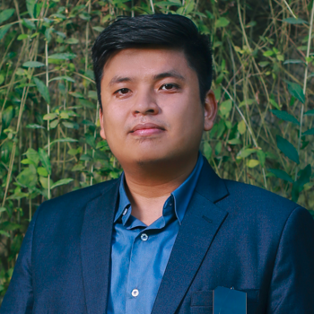
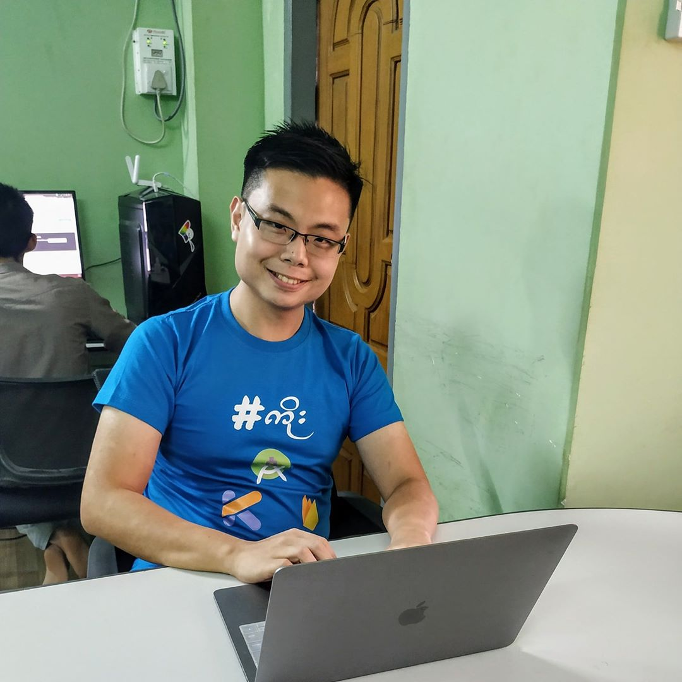
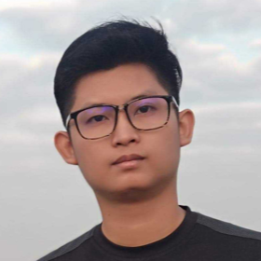
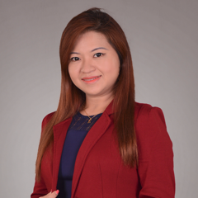

^{Main Team Members}
^{Ko Aung Pyae Phyo}
^{Chief Executice Officer}
^{Ko Zaw Htet Naing}
^{Senior Mobile Developer}
^{Ko Thet Hlaing}
Senior Director, Web & Infrasturcture
^{Ma Khin Thinda Hnin}
^{Business Development Director}
^{Ko Aung Ye Kyaw}
Deputy Director ,Web & Infrastructure

Slide 5
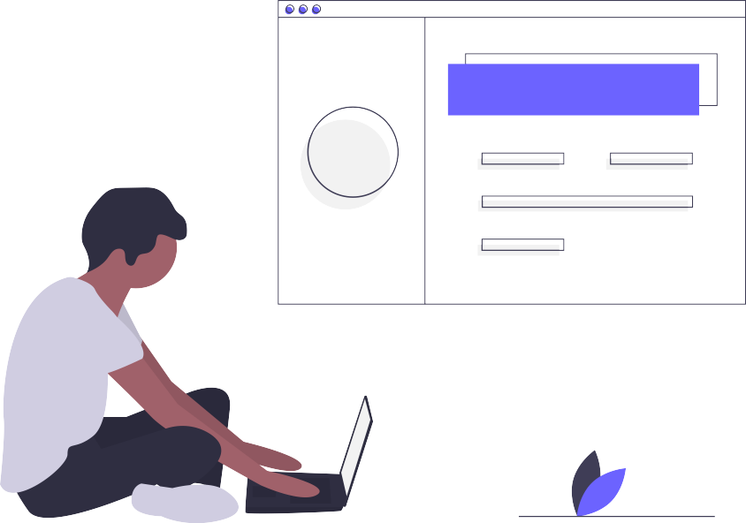
^{Technologies}
^{Web Development}
^{Vuejs + Laravel}
^{Nuxt.js}
^{Node.js}
^{Mobile Development}
^{Native-Platform}
^{Android (Java or Kotlin)}
^{IOS (Swift)}
^{Cross-Platform}
^{Flutter (Dart)}

Slide 6
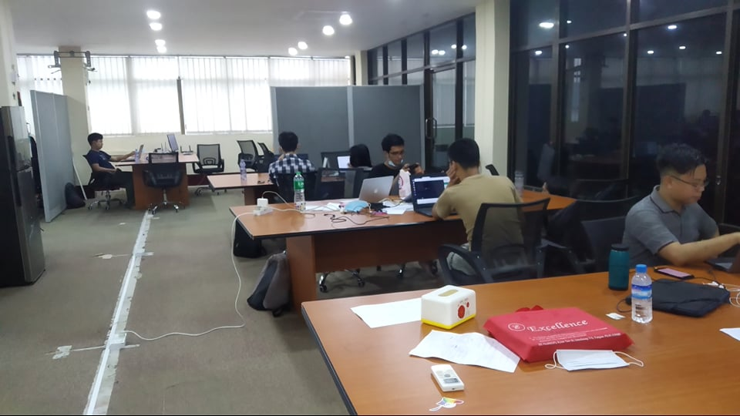
^{Company Image}

Slide 7
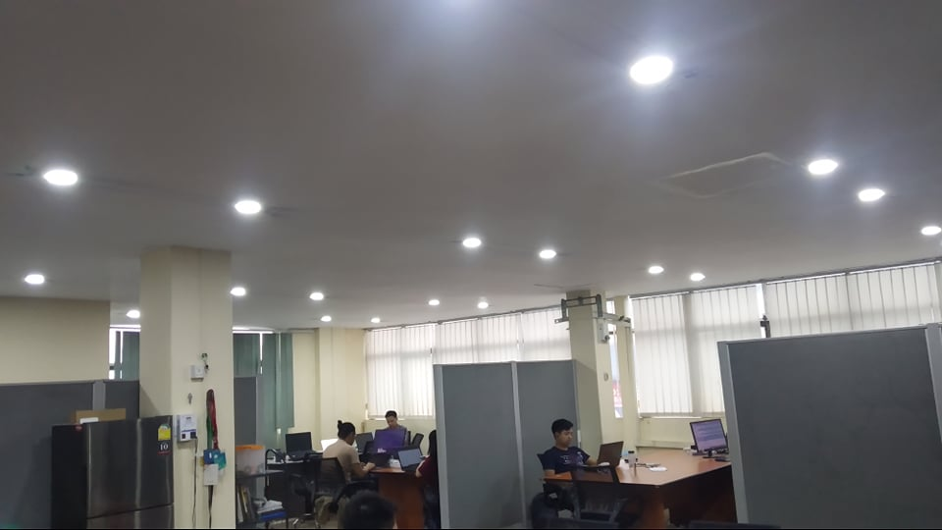
^{Cont’}

Slide 8
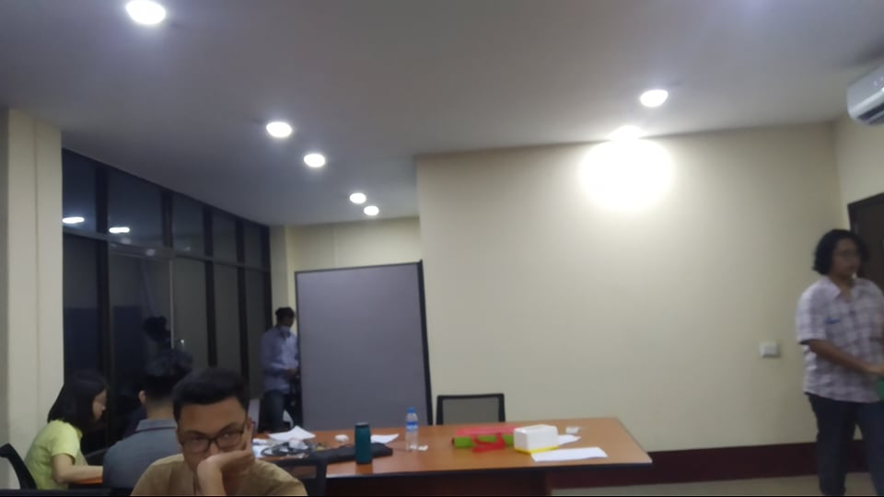
^{Cont’}

Slide 9

^{Why go to an internship?}
To get experience in the workplace
To put technology to practical use
^{To improve social relations}
How to implement real world applications using technology
^{To improve the experience}
To increase obedience and leadership skills

Slide 10
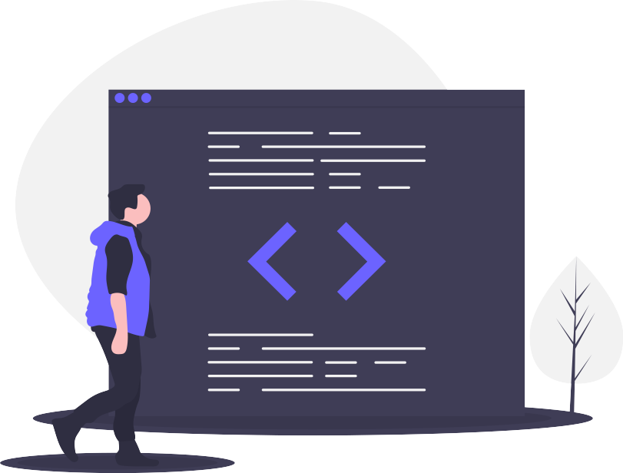
^{What should be prepared?}
You should learn the basics of the field you are going to
Common Architecture and Design Patterns
Do not lose touch with technology
You should study the design process thoroughly
You should know the basics of Version Control System
Understand the features of any IDE or Editor you use
Must be proficient in programming language
You should study Software Life Cycles

Slide 11

What kind of company should apply for an internship?
Only apply to companies that use technology that you are passionate about
Only apply to innovative companies
You should apply to a company that offers good benefits
You should apply at a company with a lot of seniors
You should apply to a company that can give you guidelines
You should only apply to a company that you can work for

Slide 12
What should I prepare to get a job before finish university?
^{Read more}
^{Do more self-study}
^{You should study English well}
You should know good English as well as technical letters
Technology should be constantly studied
You should learn a programming language to become an expert
You should know the basics of cloud services
^{Consult with seniors}
Proficiency in common languages and frameworks

Slide 13

^{My Internship Experience}
^{9 Assignments}
5 Assignments ( First Month ) ** Work From Home **
^{2 Assignments ( Second Month )}
^{2 Assignments ( Third Month )}
^{4 Projects}
^{MMDS-Player}
^{Digi-Learn and PADC Mynamar}
^{Toyo Customer}
^{S-JOY}

Slide 14
^{Cont’}
May – 19 days ( 6.5.2020 ညောင်ရေသွန်းပွဲ )
June – 22 days ( ပိတ်ရက်မရှိ )
July – 21 days ( 20.7.2020 and 31.7.2020 )
Total days = 62 days ( working days ), 91 (working days + holiday)
Total weeks = 13 weeks

Slide 15
^{Cont’}
^{Working Time}
^{9 AM to 6:30 PM}
^{Lunch Time}
^{1 hour in any time}
^{Lunch စီစဥ်ပေး}
^{Salary}
^{First 3 Assignments ( Free )}
Second 3 Assignment ( 750000MMK)
Third 3 Assignment (150000 MMK + 50000 MMK Bonus)

Slide 16
^{Cont’}
^{Used Technologies}
^{Flutter SDK}
^{Dart Programming Language}
^{Git ( Version Control System )}
Architecture and Design Patterns
^{MVVM}
^{Bloc}
^{MVP}
^{Factory}
^{Provider}

Slide 17
^{Cont’}
^{API}
^{REST API}
^{GraphQL API}
^{Databases}
^{Hive}
^{SQL}
^{Firebase}

Slide 18
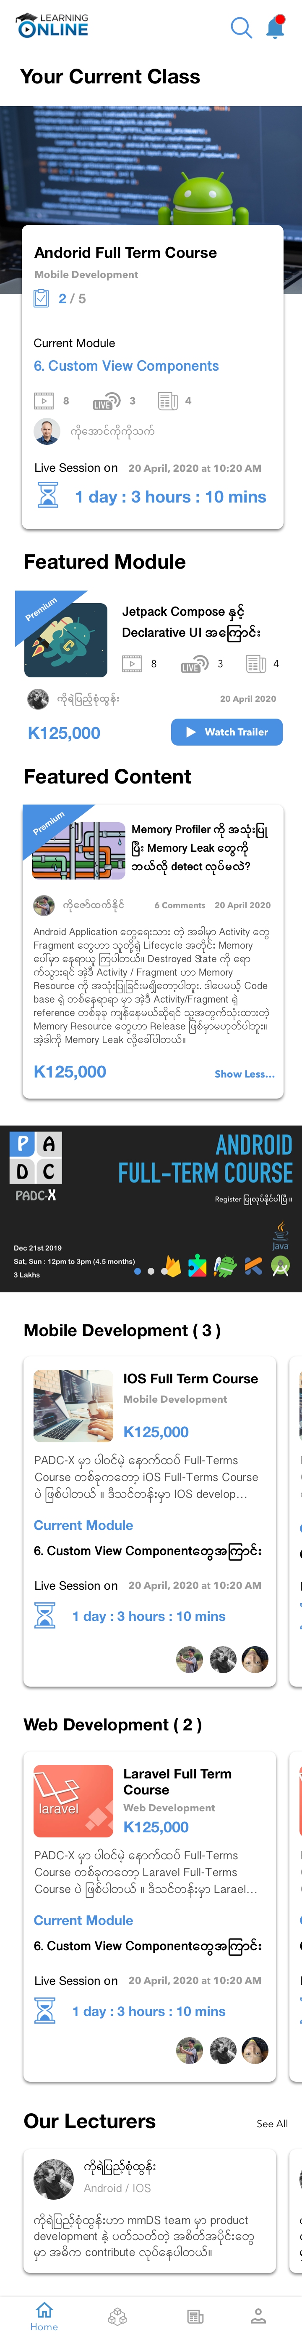
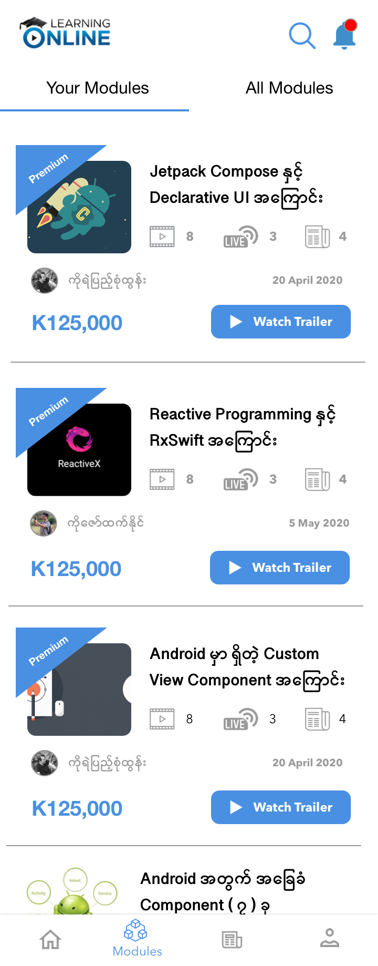
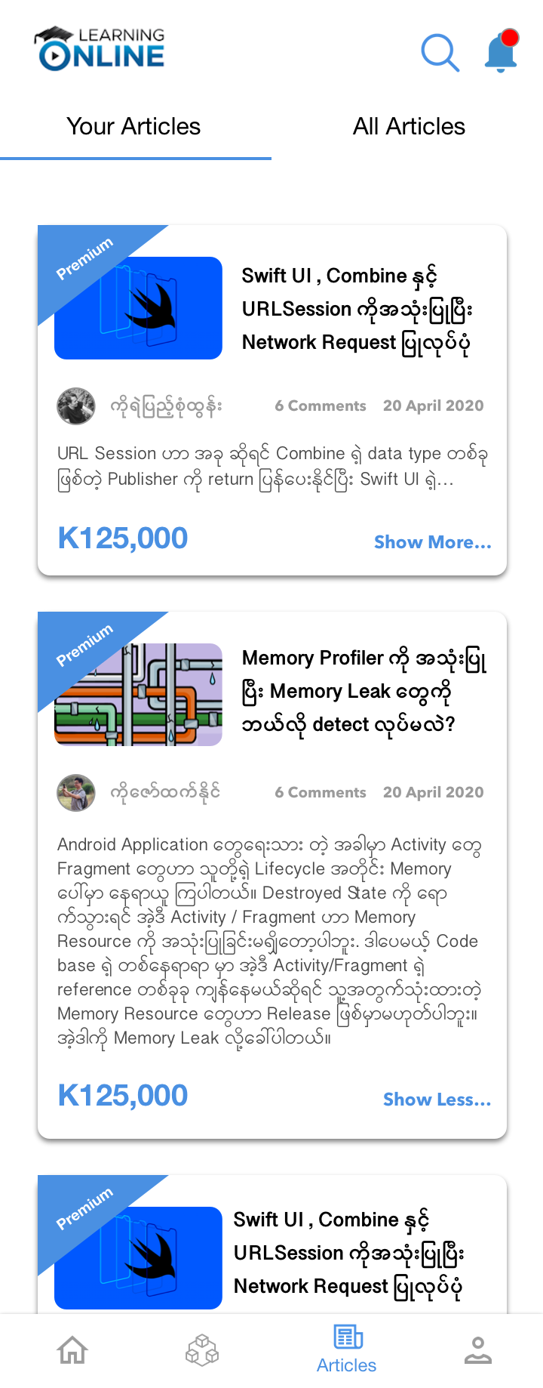
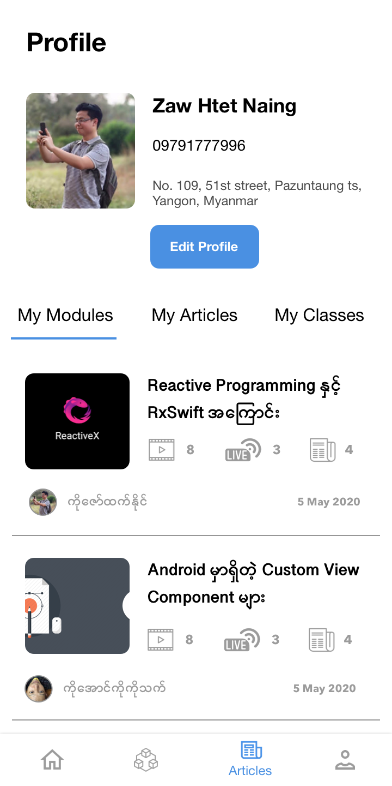
PADC Mynamar and Digi-Learn ( Two Instance)

Slide 19
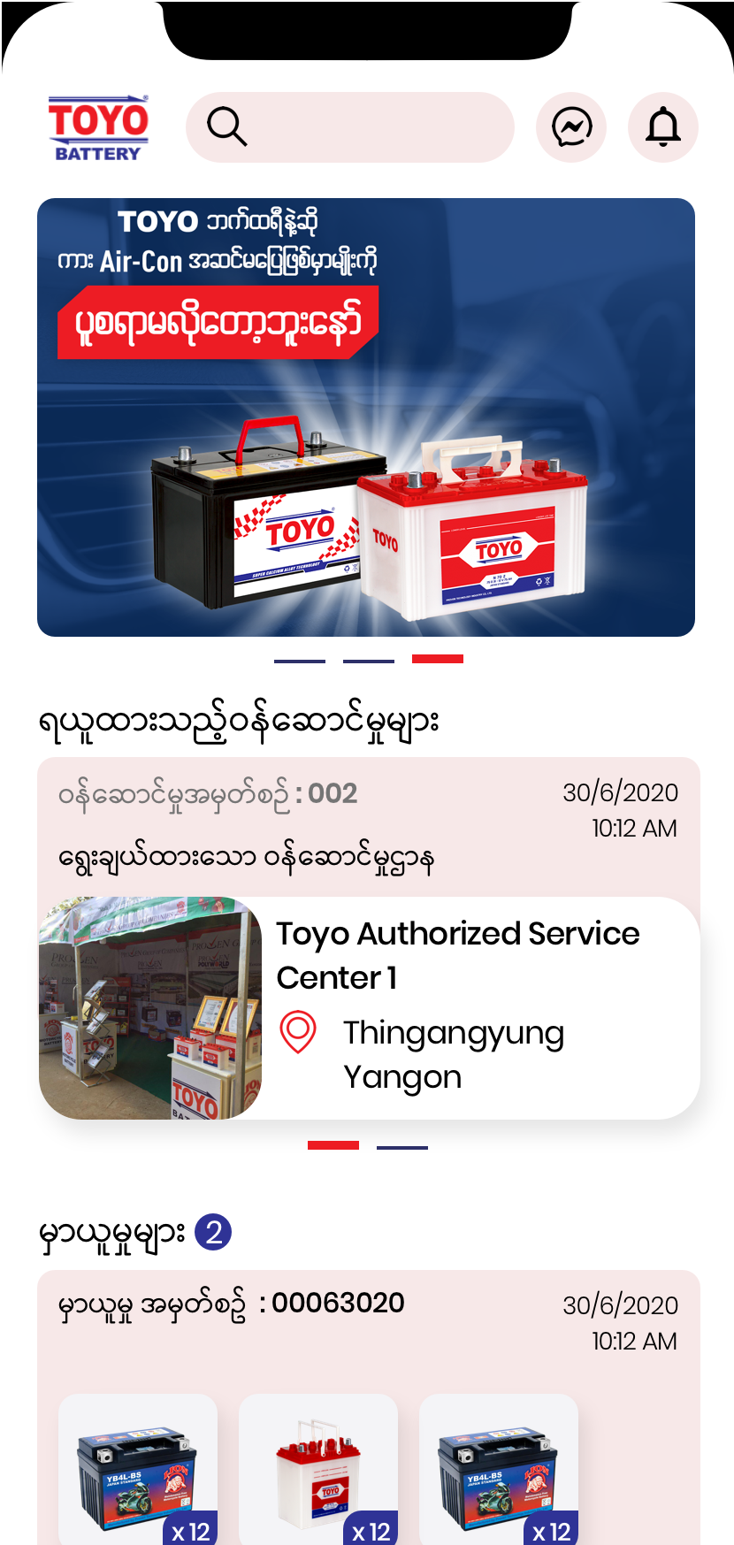
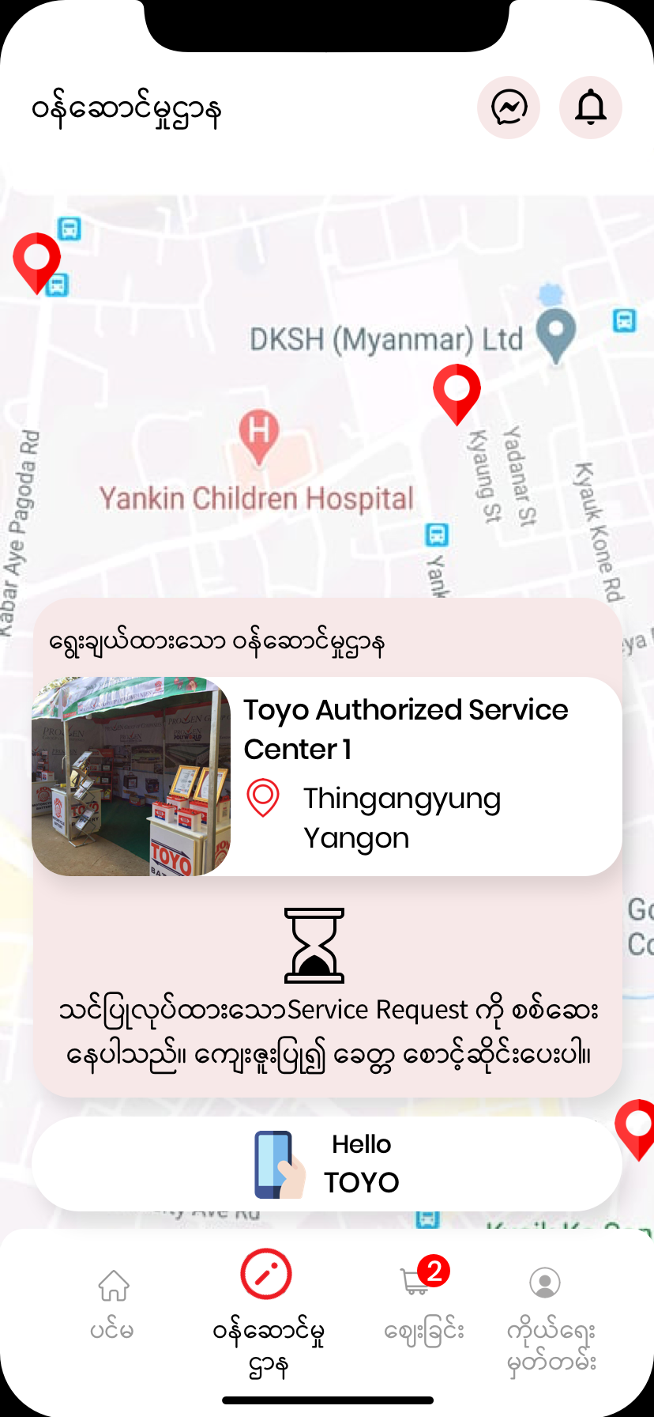
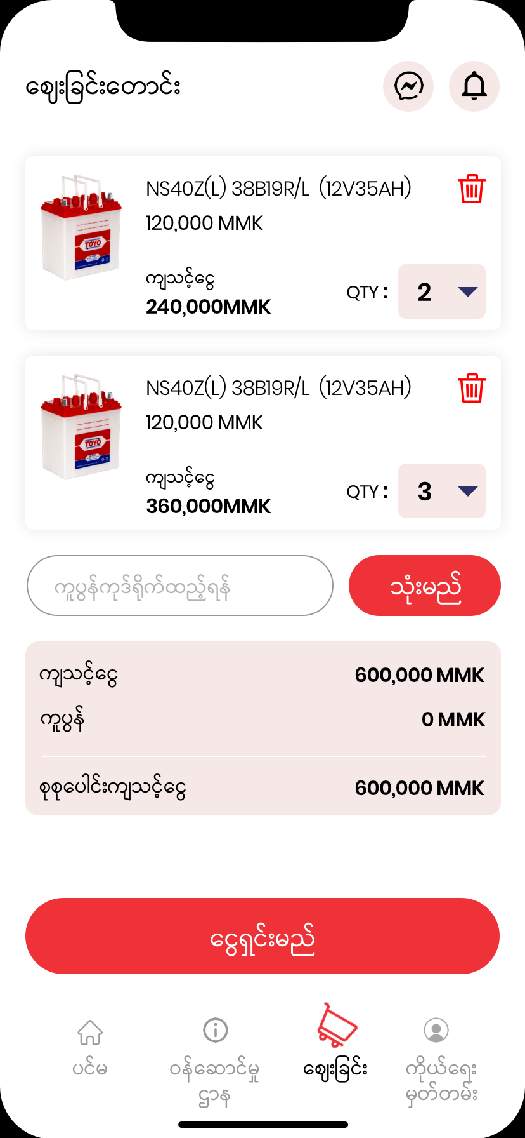
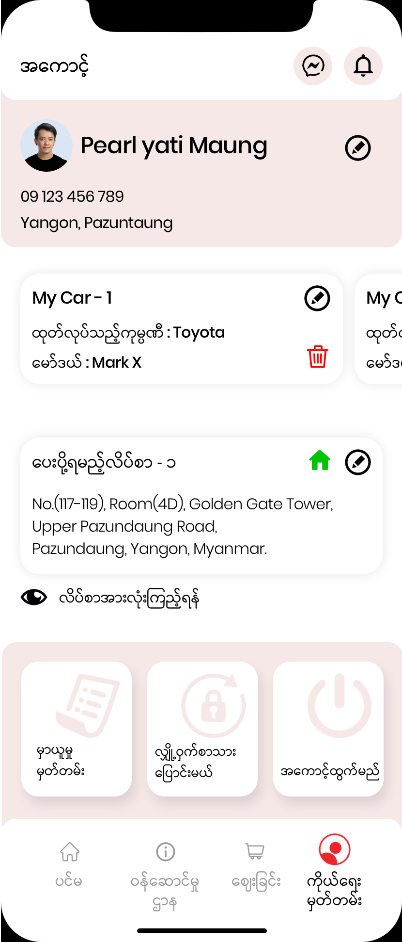
^{Toyo Customer}

Slide 20
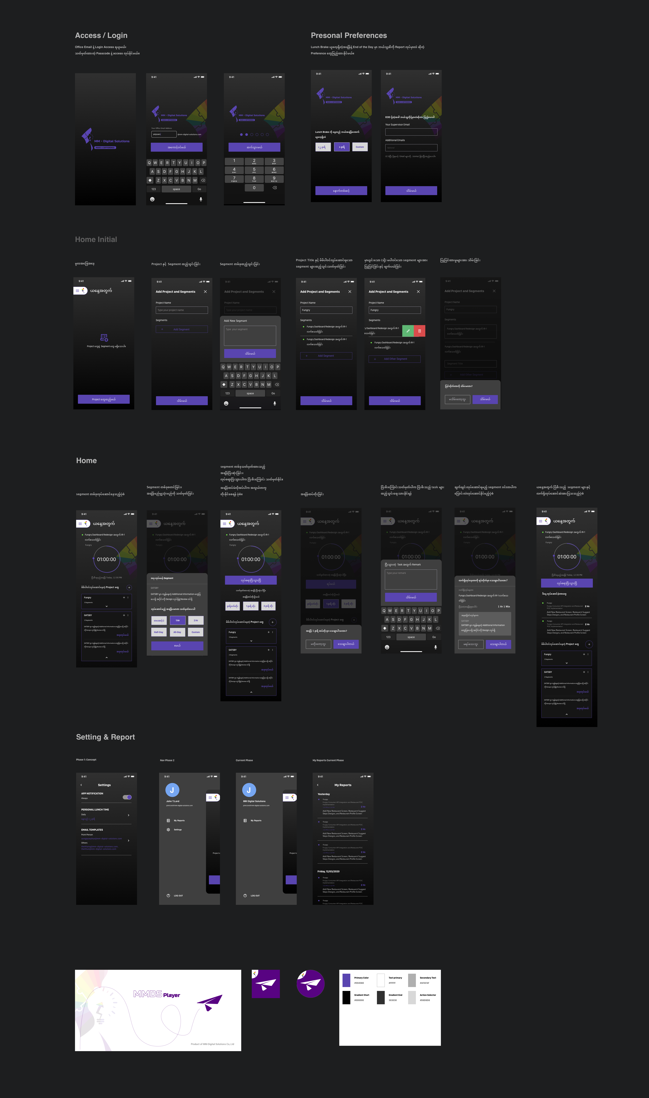
^{MMDS-Player}

Slide 21
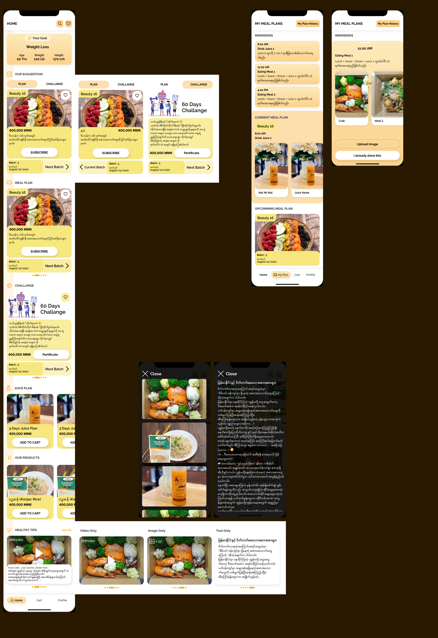
^{S-JOY}

Slide 22
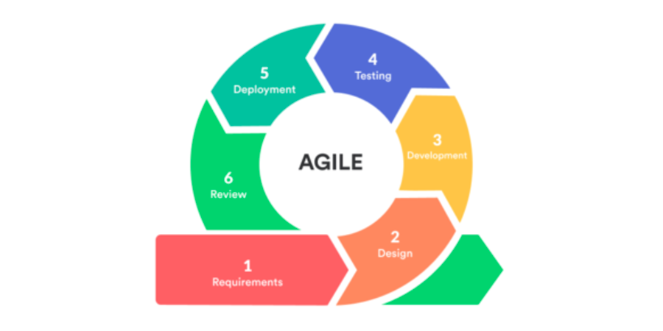
^{Software Development Method}

Slide 23
^{Development Process}
Project Requirement
Testing(alpha version)
Release(beta version)
Project Schedule
Persistence Data
Client Confirmation
UI Design illustration
API Integration
Release (stable version)
POC implementation
UI Testing

Slide 24
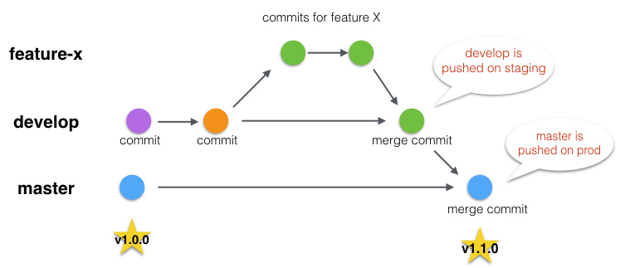
^{Version Control System}

Slide 25

^{What were the challenges?}
^{Corona Effect}
^{Device Specification}
^{Bus Car}
^{Software Architecture}

Slide 26
^{Conclusion}
Software architecture, thinking skill, coding skill and communicaiton skill are very important in real world application development and also need to study software development methods and processes, and version controlling system.

Slide 27
^{Thank You For Your Attention}

